Slide 1
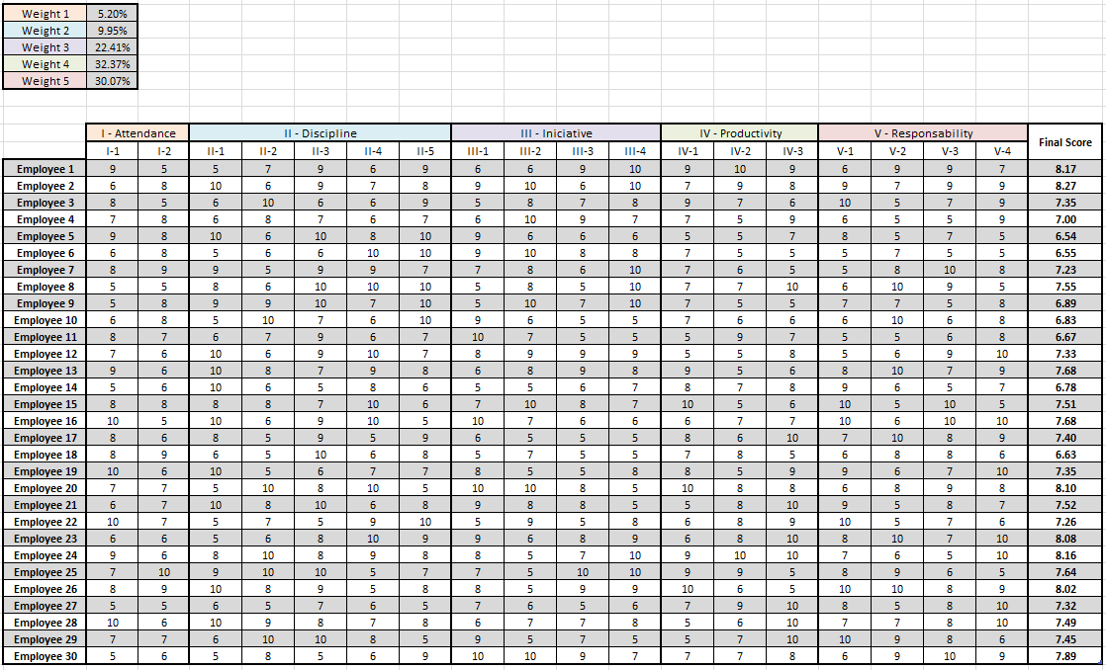
Spreadsheet for computing the employee’s Overall Score
Weights for each category analyzed. (Obtained through Survey)
Each category is evaluated along multiple indicators.
Final Overall score to be considered
One row for each Employee individual scores

Slide 2
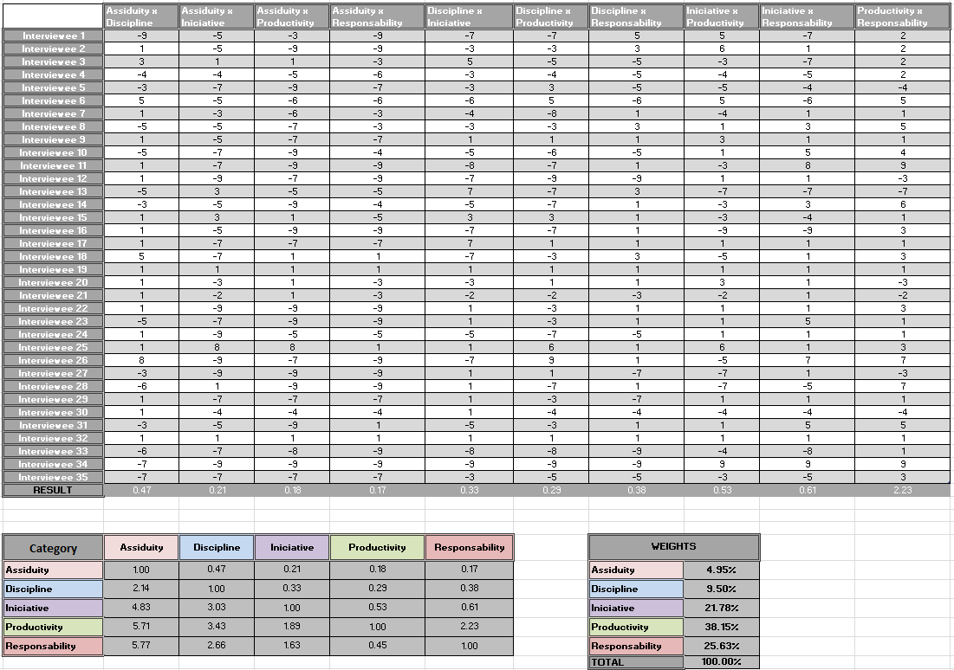
Spreadsheet for computing the categories’ weights
Opinion collected from the stakeholders. (See Form)
Results enter into a pairwise comparison matrix.
The eigenvector will give us the weights

Slide 3
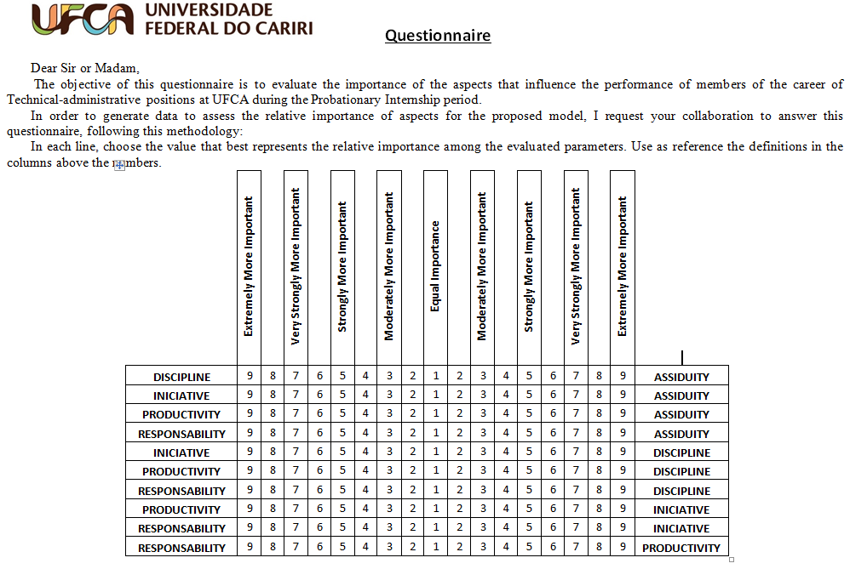
REFERENCE FOR THE QUESTIONNAIRE
Text Reference
For each line, the surveyed will select one value.
Values on this side will be inputted as negative in the weights spreadsheet.

